Slide 1


CRESYM
Collaborative Research for Energy SYstems Modeling
BIGER project: Project deliverables and Lessons learned

Slide 2

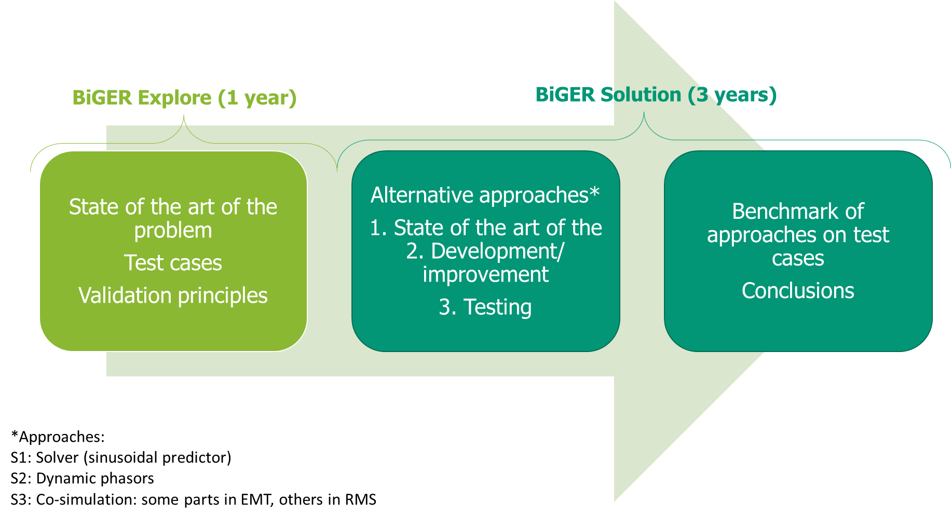

BiGER1 – Bridging the Gap between EMT and RMS models – Context and objectives
Assess the quality of new approaches (other than classical EMT and RMS) for ensuring the system stability in situations with a large penetration (up to 100%) of Inverter-Based Resources (IBR) and identify their potential improvements to develop in a follow-up project
BiGER explore (1Y)
Build and share a set of use cases and their associated open-source benchmarks that illustrate the need for more detailed simulations. Clear stability assessment criteria and interesting scenarios are part of each test system.
Build and share a state of the art of the problem developed to handle this issue
BiGER solution (3Y)
developing alternative simulation approaches which are foreseen to be of three different kinds: co-simulation, dynamic phasors, sinusoidal predictor method, etc.
Methods are implemented and tested in those benchmark cases

Slide 3
BIGER1 Explore - Deliverables
BiGER project State of the art (not finished)
Test systems
1-VSC test system
4-VSC test system
Nordic test system
Use_cases_report_Nordic_4VSC

Slide 4
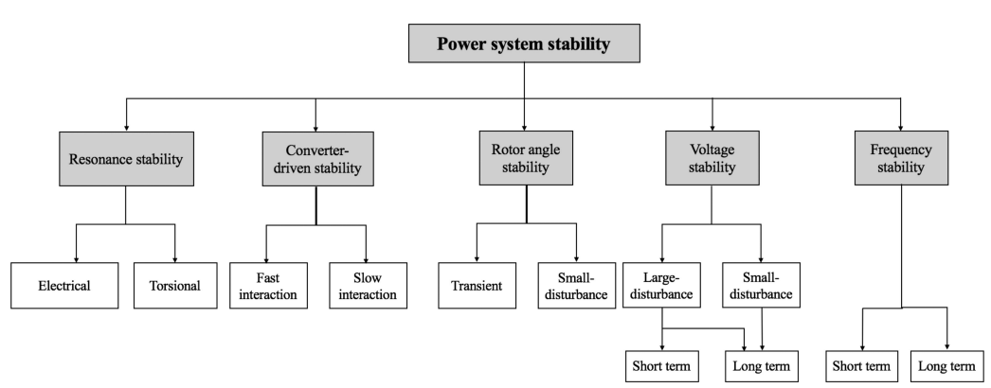
BIGER1 Explore – State-of-the-art
Starting point: for which dynamics is the phasor still valid ?
NEW CATEGORIES
EMT is clearly required
Hatziargyriou N. et al. « Definition and Classification of Power System Stability – Revisited & Extended ». IEEE Trans. on Power Systems 36, nº 4 (July 2021), pp. 3271‑81 https://doi.org/10.1109/TPWRS.2020.3041774
Limit of validity of phasor approximation
All categories are impacted by the presence of IBRs
Power-electronics converters push the phasor approximation to its limit (and beyond…)

Slide 5
State-of-the-art review Key messages
BiGER PROJECT
RMS limitations from type of phasor model
What are Phasor models?
Simplified Average Value Models: AC- and DC-side modeled as controlled current and voltage sources in the phasor domain (for dynamic simulation)
Different possibilities to model the control systems
Load-Flow Models: Primarly designed for steady-state analysis in RMS simulations (for static simulation)
Limitations are significant with grid-following inverter models
RMS limitations from increasing number of IBRs in the network
Considerable effect of several parameters
Type of event (fault, load step, controller setpoint changes)
Network initial operating point/state
Strength of external network (short-circuit power/ short-circuit ratio)
PLL bandwidth
Controller parameters (e.g. time constant of inner current loop)

Slide 6
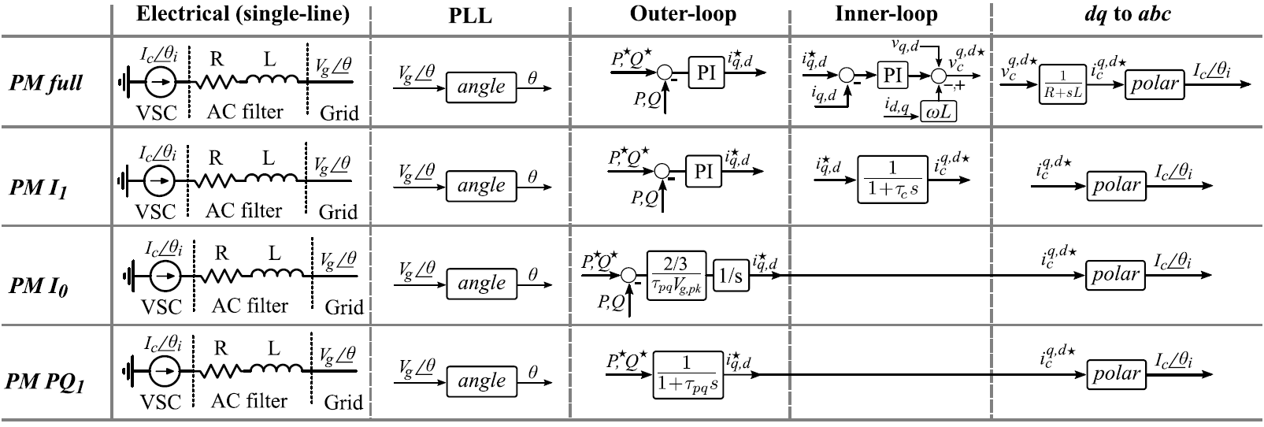
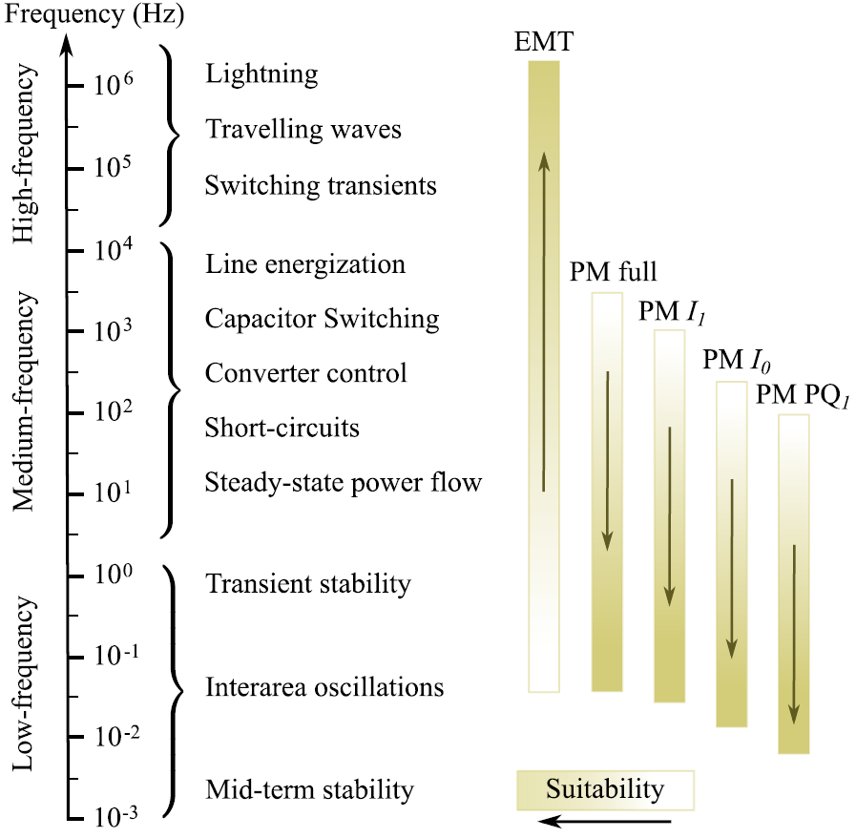
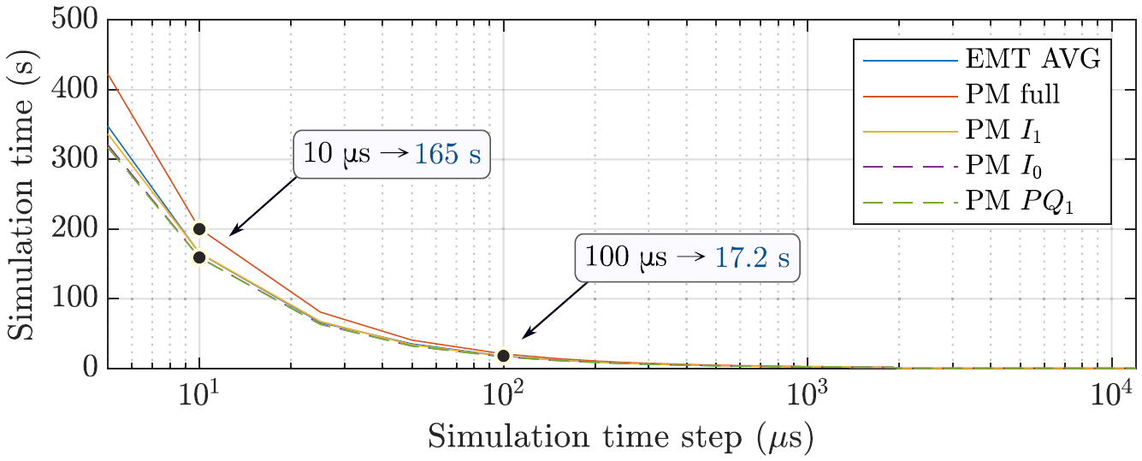
Limitations from phasor model – Literature findings
BIGER PROJECT
Full Phasor Model
Complete structure is preserved
Phasor Model I1
The inner control loop is substituted by a first-order transfer function
Complex enough to reflect real-life systems
Phasor Model I0
The voltage-source inverter inner loop is completely removed
Allows larger time steps
Phasor Model PQ1
Outer-loop is substituted by a first-order transfer function
Dependency between selected phasor model and simulated frequency range
Vinicius A. Lacerda – “Phasor Modeling Approaches and Simulation Guidelines of Voltage-Source Converters in Grid-Intergration Studies“, IEEE Access, vol. 10, 2022

Slide 7
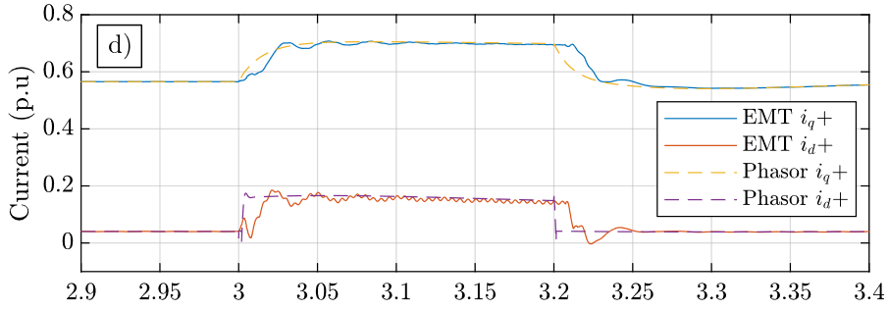
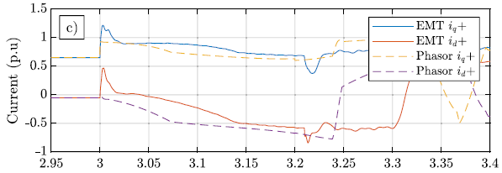
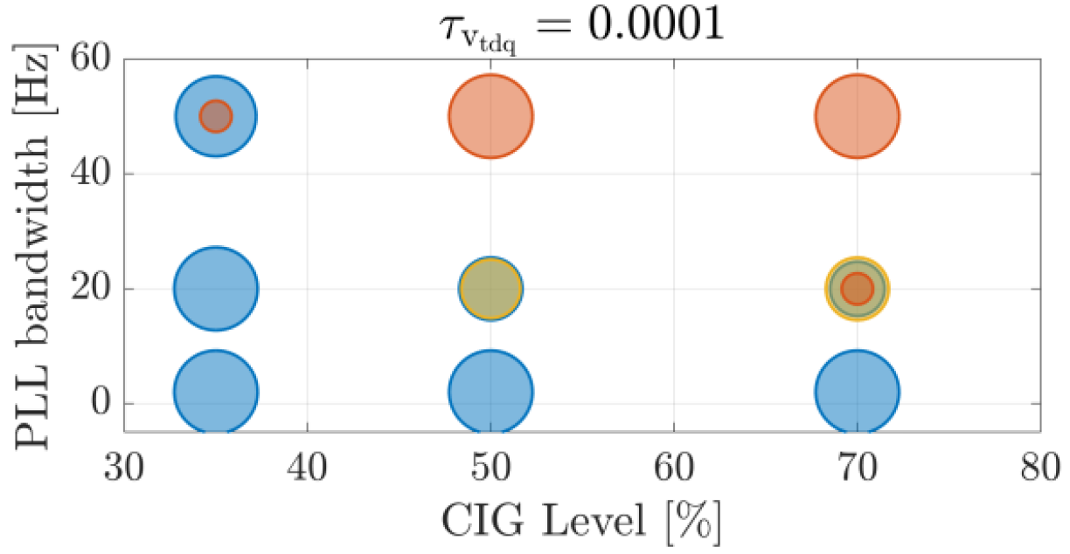
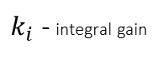
Limitations from increasing number of IBRs – Literature findings
BiGER PROJECT
Limitations of simulation accuracy from increasing number of IBRs
Single-phase fault with 50% shares of GFM and GFL
Single-phase fault with 100% shares of GFM and GFL
Time (s)
Time (s)
Vinicius A. Lacerda – “Phasor and EMT models of grid-following and grid-forming converters for short-circuit simulations“, Electric Power Systems Research 223, 2023
Models validity range as function of increasing number of IBRs and selected influencing parameters
$k_{i}$ - integral gain
All QPC models are suitable
70-200
VS – Type II (I0) is unsuitable,
and the rest of the models are suitable
190-200
All QPC models are not suitable
Vega Herrera – “Validity range of stability assessments based on quasi-static phasor calculus in power systems with high levels of converter interfaced generation“, PhD Dissertation, 2022

Slide 8
BIGER Explore – Test systems
A test case should:
Exhibit an instability (slow converter driven, angle, frequency, short-term voltage)
Exhibit the phasor limitation, ideally on a industry-type stability criteria (e.g. CCT)
Be implemented with both EMT and RMS approaches
Be either small (< 100 nodes) for fundamental study, deeper understanding of the determining factors
Involve a larger system (> several 100 nodes) to draw more general conclusions
Be analyzed to identify key influencing factors

Slide 9
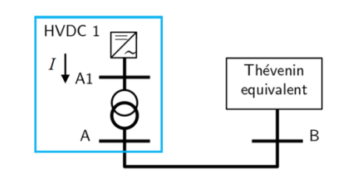
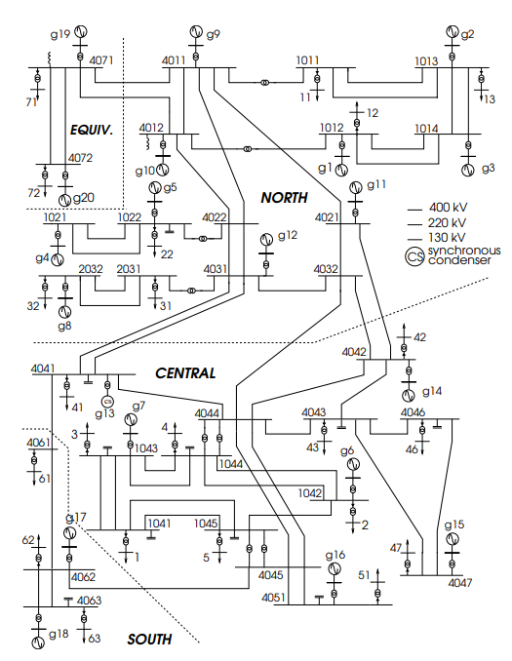
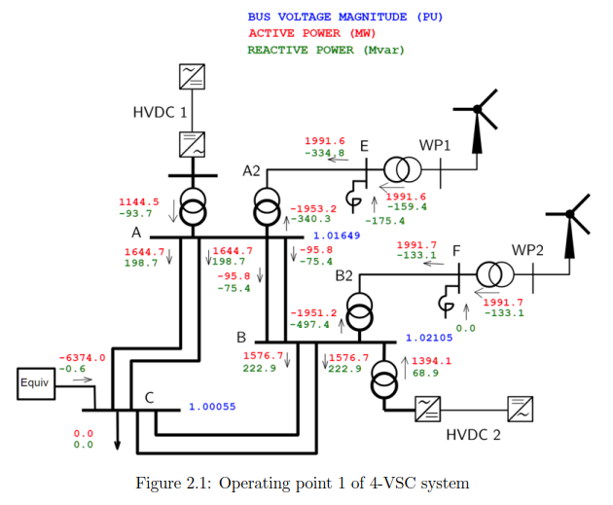
BIGER Explore – Selected test systems
1-VSC test system
IEEE Nordic Test system
As a validator of the VSC model
Medium-size test system for long-term voltage stability studies, modified with IBRs to exhibit short-term voltage instability
4-VSC test system
Small system exhibiting converter driven slow interaction dynamics.
For more information see:
C. Cardozo, T. Prevost, S.-H. Huang, J. Lu, N. Modi, M. Hishida, X. Li, A. Abdalrahman, P. Samuelsson, T. Van Cutsem, Y. Laba, Y. Lamrani, F. Colas, and X. Guillaud, “Promises and challenges of grid forming: Transmission system operator, manufacturer and academic view points,” Proc. 23rd Power System Computation Conference, (invited paper)

Slide 10
BIGER Explore – Test systems – tools selection
Priority given to open-source tools when available
Main challenge: identification of limitations from physically-driven model behavior vs numerically-driven solver behavior
STEPSS: open-source RMS tool (Univ. of Liège by T. Van Cutsem)
Strict separation between modeling and solving parts
Equation-based modelling using proprietary language
Available collection of relevant converter test models, test systems and test cases
Dynawo: open-source hybrid C++/Modelica RMS tool (RTE)
Strict separation between modeling and solving parts
Equation-based modelling with high-level modeling language Modelica
Third party advanced open-source solvers
EMTP-RV: EMT tool (EDF, Hydro-Québec and RTE)
Based on nodal analysis/ resistive companion (Dommel's approach)
Widely used by industry and academia
Possibility to access and understand the code in collaboration with EMTP developers from RTE.

Slide 11
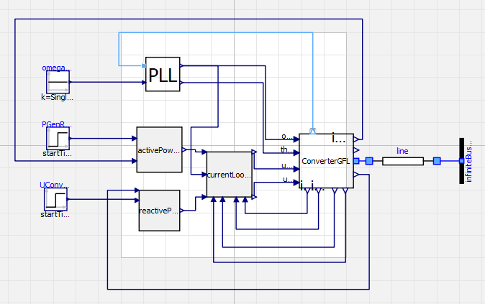
BIGER Explore – 1-VSC test system
Single Grid-FoLlowing (GFL) VSC connected to a Thévenin equivalent
GFL VSC model:
Generic GFL model with PQ or PV control
Start with detailed model reported in literature
Complete control structure is preserved
PLL, inner current loop, outer Active power control loop, outer Voltage/ Reactive power control loop
Model description: see details in appendix
RMS :Collaborative Open-Source Dynamic Simulation Library
EMT: see Use case report
Model implementation
STEPSS: inj_GFOL_det.txt
Dynawo: dynawo/dynawo at 3093_GFL_VSC (still not merged)
EMTP
Notes:
RMS GFL model:
MMC type converter connected to a transformer to the grid, no LC filter.
V_dc is constant, transformer with differential equations, and current control loops fast but not infinite.
EMT GFL model:
Abc description and park transform, AVMs models
No LC filter, transformer magnetization is neglected, no protection scheme,
Additional initialization scheme

Slide 12
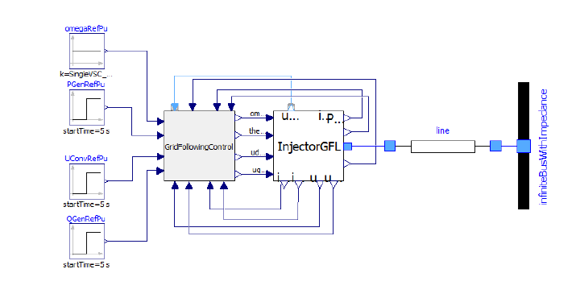
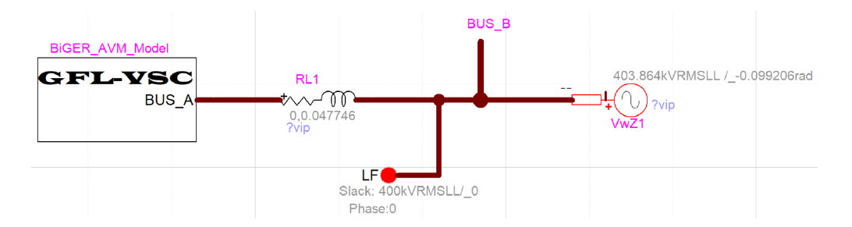
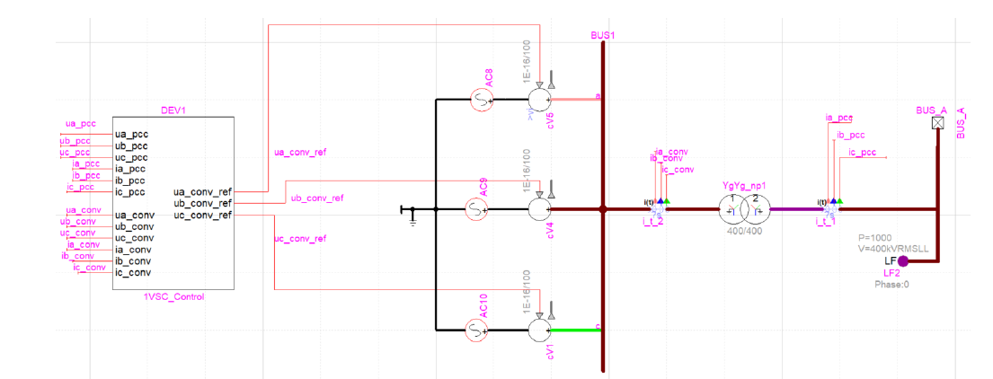
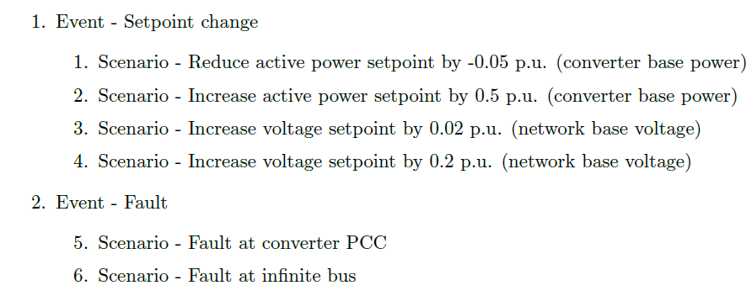
BIGER Explore – 1-VSC test system - implementation
In EMTP
In Dynawo
EMTP
Comparing master...3093_GFL_VSC · dynawo/dynawo
In STEPSS : see separate slides
4 events are tested :

Slide 13
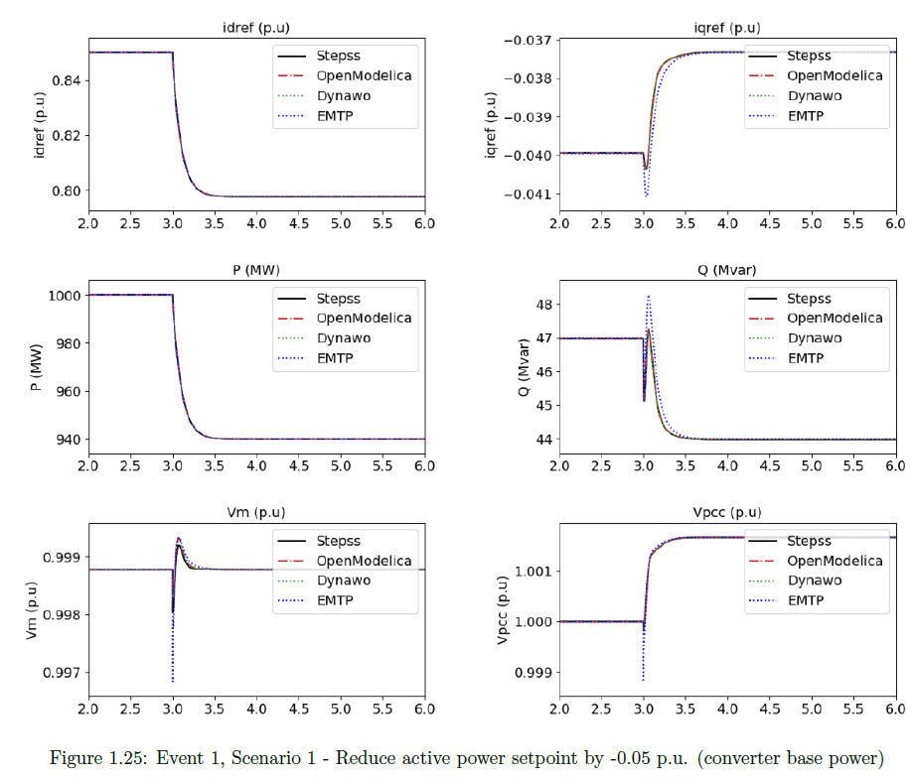
BIGER Explore – 1-VSC test system - validation
Example of results : active power setpoint decreased by 0.05 pu
Minor differences between EMT and RMS
No difference between both RMS simulators (STEPSS and dynawo)

Slide 14
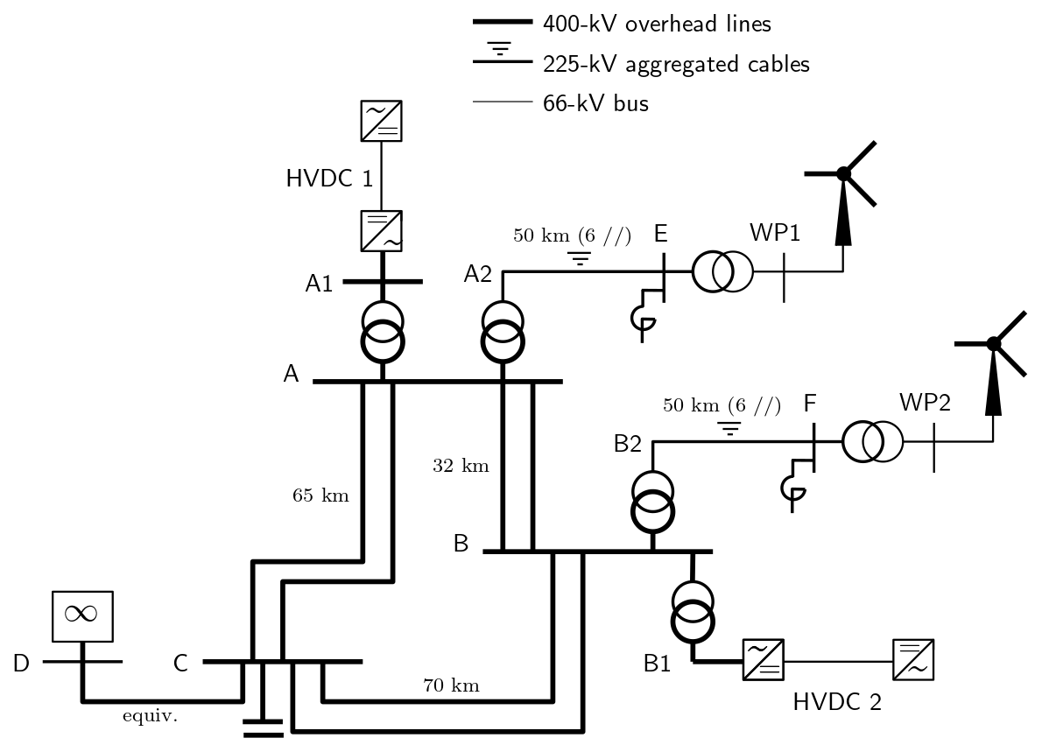
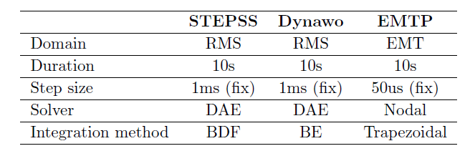
BIGER Explore – 4-VSC test system – description
Converter driven instability expected
Evaluation of system level stability scenarios with 100% converter-based generation
Small enough to be easily tractable
Complex enough to reflect real-life systems
Operating point 1:
network heavily loaded
no load
power injected by WPs and HVDC links exported to external system
Operating point 2:
network lightly loaded: WP productions exported by HVDC links
load at bus C adjusted to have a zero power export to the external equivalent connected to bus C
larger shunt inductors connected to avoid high voltages
Events:
mild disturbance: 400-kV line disconnection between A and B
severe disturbance: threephase fault on line A-C

Slide 15
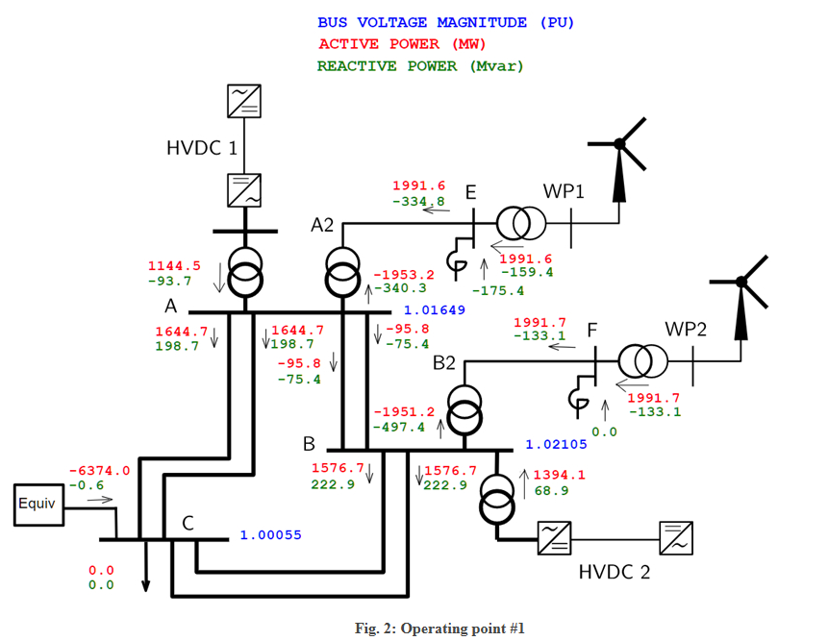
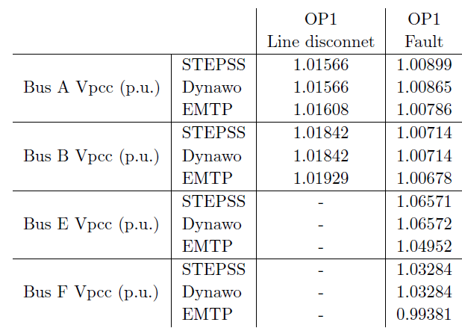
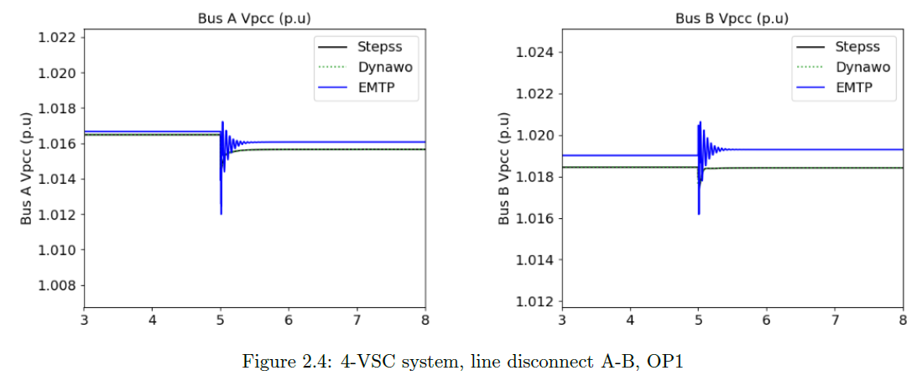
BIGER Explore – 4-VSC test system – results @ OP1
Steady-state values after the transients
Minor differences with no impact on overall conclusions
Notes:
OP1
Heavy loaded network, big production of wind farms, export by equiv network bus C.
N-1 secured.
SCP of 10GVA at bus C.

Slide 16
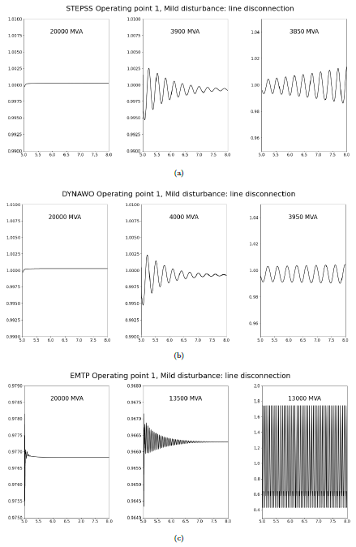
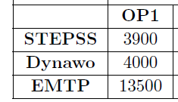
BIGER Explore – 4-VSC test system – results @ OP1
Stability limit as function of External Network Strength
Short-circuit power of external system decreased from 20 000 MVA down in 500-MVA steps
A mild disturbance is simulated
Stability limit reached when oscillations become unstable

Slide 17
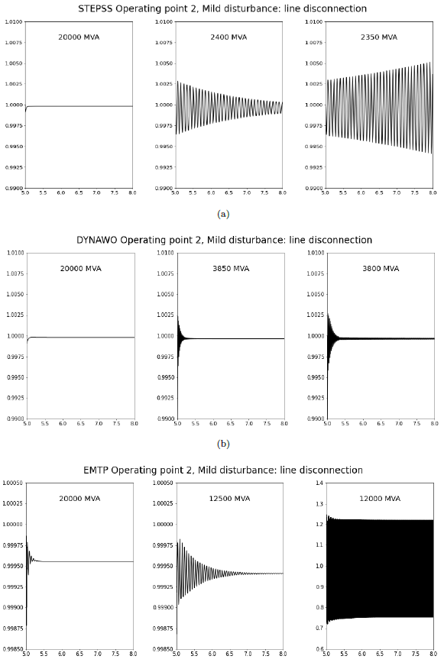
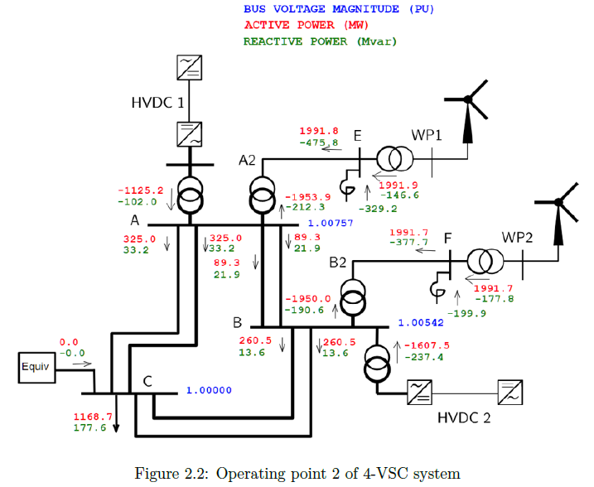
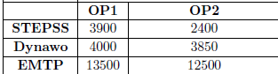
BIGER Explore – 4-VSC test system – results @ OP2
Steady-state values after the transients :
Minor variations with no impact on overall conclusions
Stability limit as function of External Network Strength
The high-frequency oscillations observed in Dynawo for OP2 when approaching
the stability limit are related to the solver configuration. These oscillations can be altered by adjusting the
solver parameters. This aspect requires further investigation
Notes:
Same power from the wind park, but large fraction evacuated through HVDC, large shunt reactor connected
Stability is evaluated in terms of minimal short circuit power of the external system, but variying the Thevenin reactance. No exchange with external grid.

Slide 18
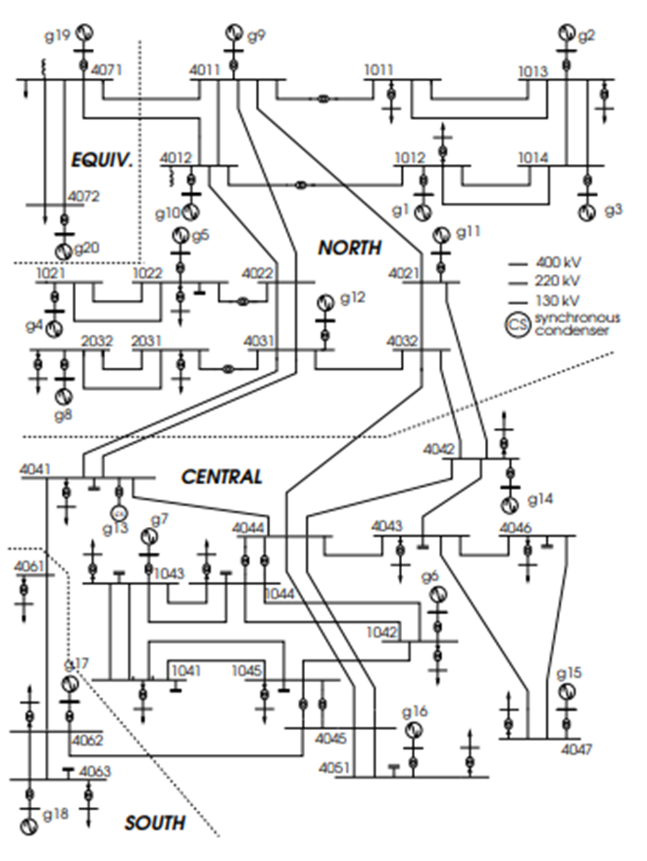
BIGER Explore – Nordic test system
Well-documented IEEE benchmark test system [1] initially intended for long-term voltage stability studies
suitable for EMT simulations and their comparisons with phasor-mode simulations
shifted from long-term to short-term voltage instability by replacing some synchronous generators with Voltage Source Converters (VSCs)
Nominal frequency (Hz) | 50
No. of buses | 74
No. of lines | 50
No. of transformers | 52
No. of generators | 19, represented behind their step-up transformers,
No. of synchronous condensers | 1, represented behind its step-up transformer
No. of loads | 22 at distribution level, controlled by the LTCs of the step-down transformers (not on concern in BiGer)
No. of (switched) shunts | 11
Total generation (MW) | 11506
Total load (MW) | 11060
[1] Test systems for Voltage Stability Analysis and Security Assessment, IEEE PES Technical Report PES-TR19, Aug. 2015

Slide 19
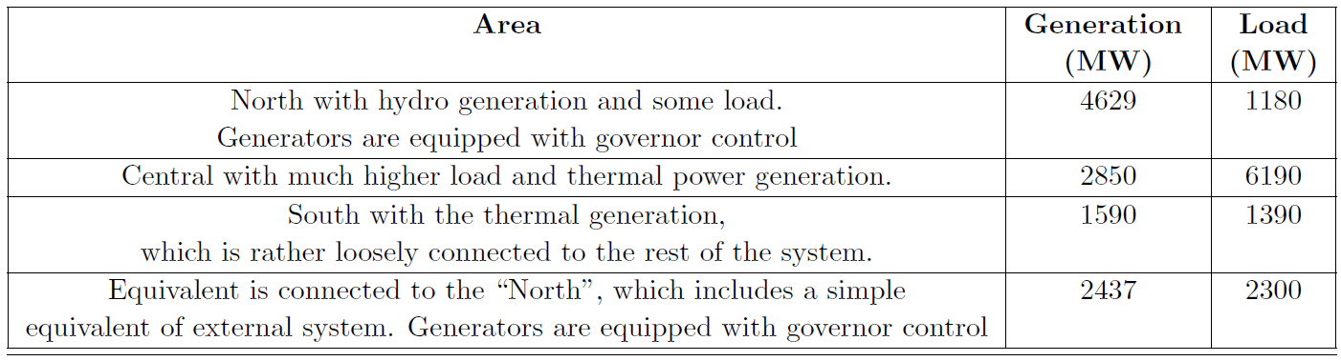
BIGER Explore – Nordic test system

Slide 20
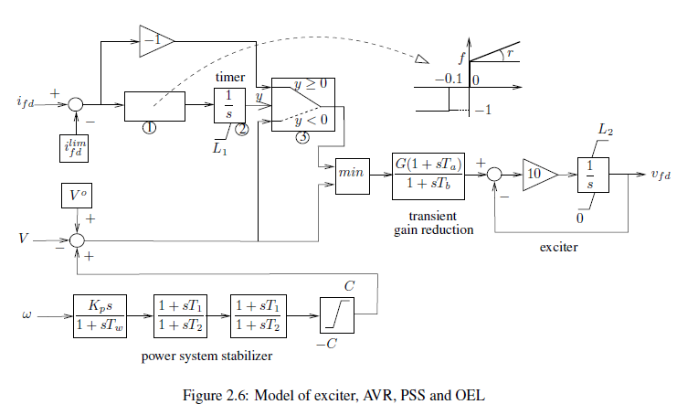
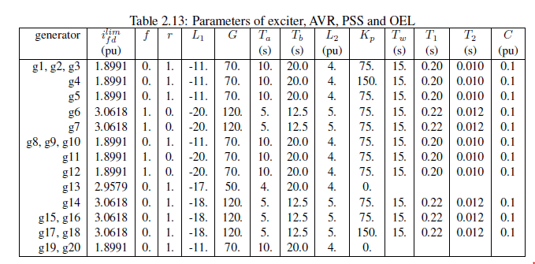
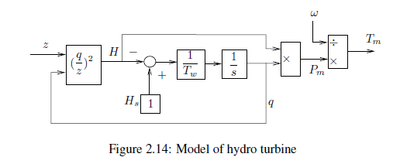
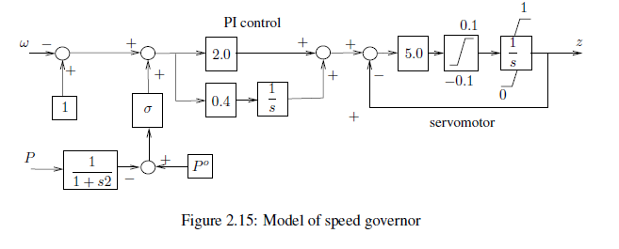
BIGER Explore – Nordic test system – generator controls

Slide 21
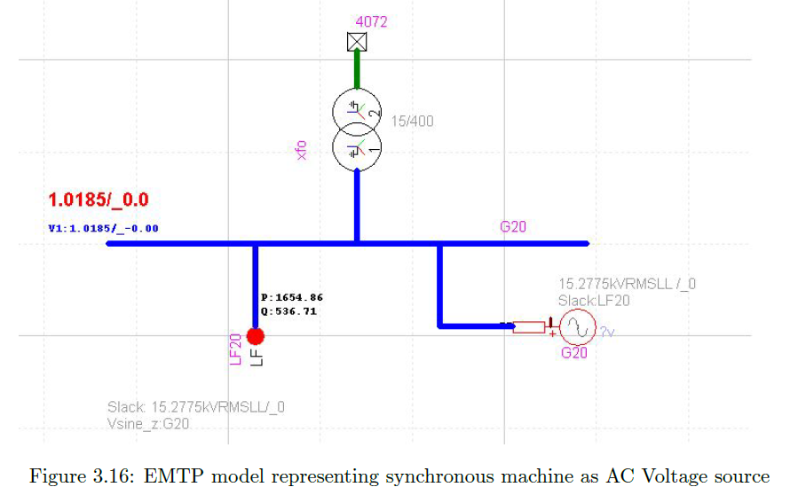
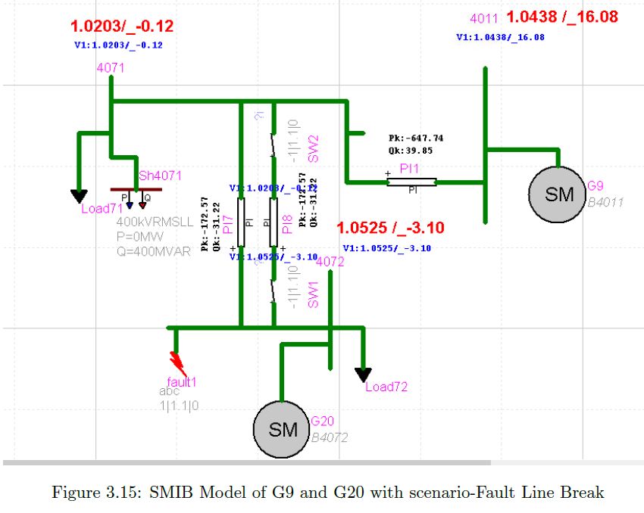
BIGER Explore – Nordic system – tests with SGs
First, the EMTP model was checked with the original Synchronous Generators (SG).
The following tests were implemented:
Generators replaced by AC voltage sources for load flow analysis only
Two-machine sub-system tested for validation of the generator models
with and without saturation represented
Simple AVR and PSS considered
Two-machine sub-system tested for validation of the turbine, governor and exciter models
Full detailed Nordic system
In all those tests, the following events were simulated:
Increase of a voltage setpoint by 0.05 pu
Three-phase solid fault on a bus, fault duration of 5 cycles (0.1 s)
Fault cleared by line opening

Slide 22
BIGER Explore – Nordic system – tests with SGs
The following tests were implemented:
Generators replaced by AC voltage sources for load flow analysis only → same results as RMS (STEPSS)
Two-machine sub-system tested for validation of the generator models
with and without saturation represented
Simple AVR and PSS considered
→ No discrepancy observed with respect to RMS (STEPSS)
Two-machine sub-system tested for validation of the turbine, governor and exciter models
Full detailed Nordic system

Slide 23
BIGER Explore – Nordic system – tests with SGs
Two-machine sub-system tested for validation of the turbine, governor and exciter models
Comparison between RMS (STEPSS) and EMTP
torque SM20, EMTP (red), STEPSS (blue)
wr SM20, EMTP (red),
STEPSS (blue)
wr SM9, EMTP (red),
STEPSS (blue)
Pe SM20, EMTP (red), STEPSS (blue)
Wr SM9, EMTP (red), STEPSS (blue)
Pe SM9, EMTP (red), STEPSS (blue)
Vt SM9, EMTP (red), STEPSS (blue)
Wr SM20, EMTP (red), STEPSS (blue)
Vt SM20, EMTP (red), STEPSS (blue)
q SM20 EMTP (red),
Z SM20 EMTP (blue)
Q SM20 STEPSS (pink)
Z SM20 STEPSS (green)
Pe SM20, EMTP (red),
STEPSS (blue)
Pe SM9, EMTP (red),
STEPSS (blue)
Comparison of the governor response for 50% load decrease at bus 71 on a small system having G9 and G20 detailed models
Response of Gen 9 and 20 to fault cleared by line break
High frequencies appear with EMTP during transient but good match on steady state values
Small discrepancies between RMS and EMT

Slide 24
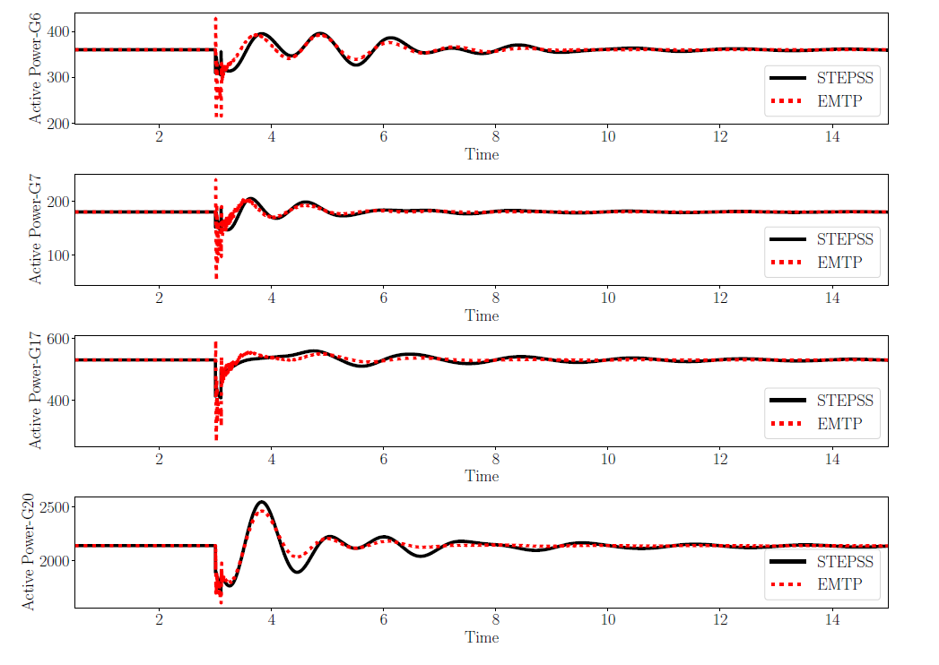
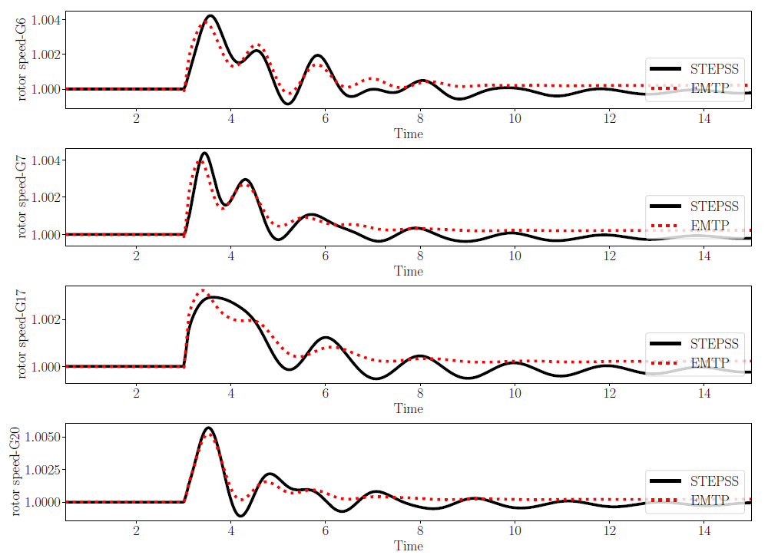
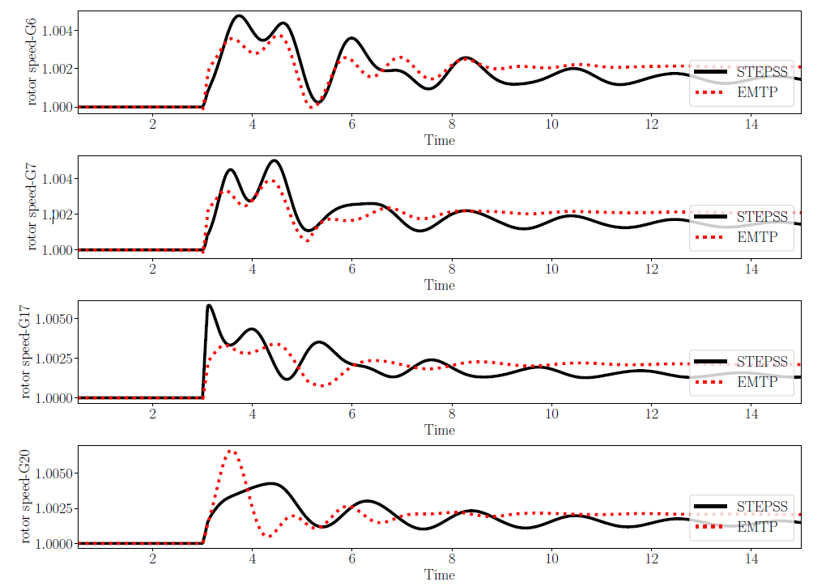
BIGER Explore – Nordic system – tests with SGs
Full detailed Nordic system
Fault at bus 4032 cleared without and with line opening
Fault at bus 4032 cleared without line opening.
Active power of generators 6, 7, 17 & 20
Fault at bus 4032 cleared without line opening.
Rotor speeds of generators 6, 7, 17 & 20
Fault at bus 4032 cleared with line opening.
Rotor speeds of generator 6, 7, 17 & 20
Significant discrepancies between EMT and RMS (STEPSS) simulations
In the EMTP response, the (electromechanical) oscillations die out faster compared to the RMS (STEPSS) simulation.

Slide 25
BIGER Explore – Nordic system – tests with SGs
4. Full detailed Nordic system
Additional disturbance: outage of Generator G16 (producing 600 MW / 223 Mvar)
Generator outage. Active powers of generators 20, 11, 6, 7, 15 & 18
The frequency nadir is reached at almost the same time, but the 0.25 Hz oscillation is more damped in EMTP. The steady-state values are different. The power imbalance is smaller in EMTP. The load model (constant current for active power, constant impedance for reactive power) could be the cause.
To be investigated…
Generator outage. Rotor speeds of generators 20, 11, 7, 6, 15 & 18

Slide 26
BIGER Explore – Nordic system – tests with SGs
Full detailed Nordic system with classical generators
Large loss of G16 (600MW, 222,6MVAR)
Voltage at bus 1041 when subjected to G16 outage at time 1sec
Response of reactive power consumed by load 51 when subjected to generator 16 outage at time 1 sec
active power imbalance is smaller in the EMTP simulation. EMTP response shows unusual damping. → requires further inspection.

Slide 27
BIGER Explore – Nordic system – tests with SGs
Effect of different time-step sises
In EMTP, the numerical scheme was tested with steps of 25, 50 and 100 μs respectively
25 and 50 μs yield similar responses.
100 μs causes numerical oscillations.
Hence, the simulation with 50 μs steps can be trusted.
EMTP results with 50 μs and 100 μs time step

Slide 28
BIGER Explore – Nordic system – tests with 5 VSCs
Next, the EMTP model was checked replacing some synchronous machines with VSCs:
5 generators (6, 7, 11, 12, 11 & 14) were replaced by VSCs with the same nominal apparent power. The generators have large reactive power response to the disturbance
loads were turned to constant current for both active and reactive power
VSC currents were limited to nominal value, without delay (unlike synchronous machines)
The operating point is insecure with respect to long-term voltage stability.
In the presence of VSCs, system instability is
expected to take place faster.
Obtained results: the EMT model is initially not at equilibrium. To be investigated !
Active and reactive power at buses 1042, 1043,4021,4031 and 4042

Slide 29
BIGER Explore – Nordic system – tests with 5 VSCs
Disturbance : outage of generator g16
STEPSS shows a short-term voltage collapse (belonging to the slow converter-driven instability category),
while EMTP shows a stable response.
→ Caused by load model ? This requires further investigation !
EMTP response to outage of g16: voltage at bus 1041
STEPSS response to outage of g16: voltage at bus 1041

Slide 30
BIGER Explore – Nordic system – tests with 1 VSCs
Disturbance : outage of generator g16, generator G14 is replaced by one VSC.
TO BE COMPLETED.

Slide 31
Lessons learned
Do not underestimate the efforts required:
To build a use case in different tools
To compare the responses of different software
To tune the models and finally validate the test systems
To run the time-consuming EMT simulations
Working with EMT requires a high level of expertise
More complex models
Larger number of parameters and data to tune
There is not always a one-to-one correspondence with RMS modeling
Even if incomplete, it is hoped that the cases set up in BiGER Explore will be useful for the rest of the BiGER project
A young engineer/PhD student needs frequent supervision on a weekly basis (at least) to cope with this task and respect the timeline

Slide 32
Grid following converter RMS model
See here: Collaborative Open-Source Dynamic Simulation Library

Slide 33
Grid following converter EMT model
See section 1.2.3 EMTP implementation of BiGER1 use case report

Slide 34
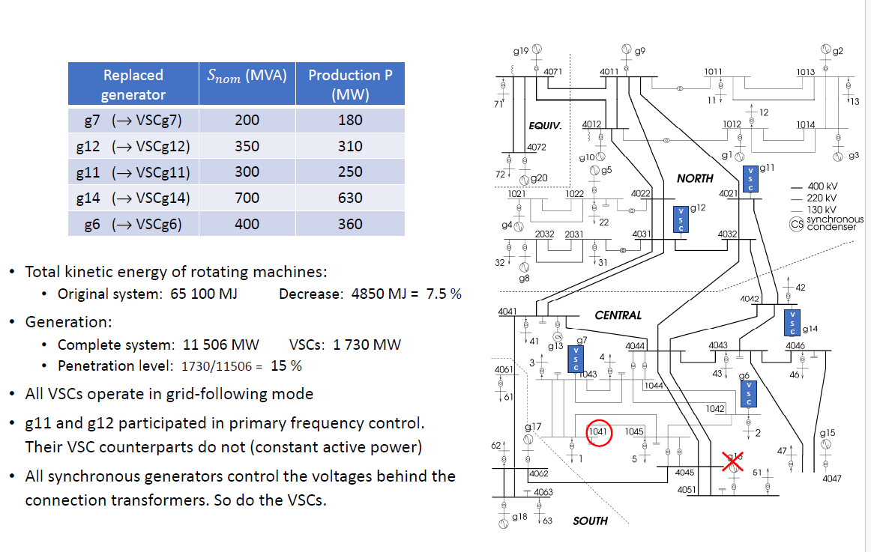
Modified Nordic system

